Slide 1

BETTER
INTERVIEWS
BETTER
WRITING
Strong Interview.
Details.
Connect.

Slide 2
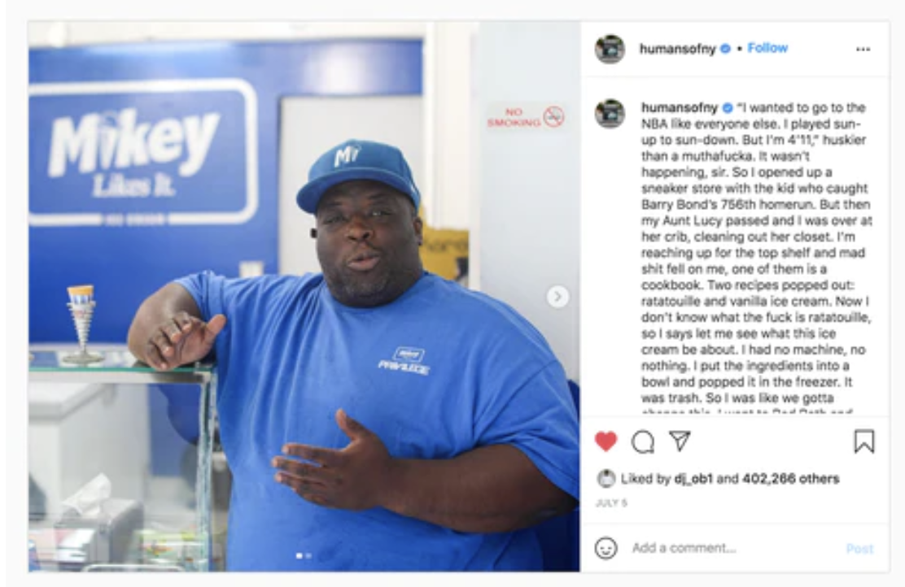
INTERVIEWING
Humans of New York

Slide 3
I wanted to go to the NBA like everyone else. I played sun-up to sun-down. But I’m 4’11,” huskier than a mother***. It wasn’t happening, sir. So I opened up a sneaker store with the kid who caught Barry Bond’s 756th homerun. But then my Aunt Lucy passed and I was over at her crib, cleaning out her closet. I’m reaching up for the top shelf and mad [stuff] fell on me, one of them is a cookbook. Two recipes popped out: ratatouille and vanilla ice cream. Now I don’t know what the heck is ratatouille, so I says let me see what this ice cream be about. I had no machine, no nothing. I put the ingredients into a bowl and popped it in the freezer. It was trash. So I was like we gotta change this. I went to Bed Bath and Beyond and got a tabletop ice cream machine, and then it was like: ‘Oh, I see what this is.’ People started coming over to my crib. They’re saying: ‘Mikey, this ice cream is good.’ Then somebody told my mom that I was an ice cream man now, and I wasn’t gonna sell weed no more. She got so excited I was like: ‘Now I gotta open up a shop.’ I’m gonna be honest—I thought it was put the scoop in a cup. But it’s a whole bunch of other [stuff] too. I got no line of credit, no nothing. I just use whatever cash is coming into the register. Every time I run out the bill collectors come and throw stones at me. If Ben and Jerry’s grew up in the hood, that’s what we’re dealing with here. But we’ve been open for eight years. Black Enterprise Magazine called this place a ‘safe haven.’ You know how every gangsta’s got a grandma saying: ‘Sit down baby, have some food.’ That’s what this about. It’s bigger than ice cream. I grew up two blocks from here, so on Thanksgiving I’m blasting out hot food in the projects: turkeys, sandwiches, mashed potatoes. We put on for the community. That’s what we do. Cause if you ain’t doing it for the community, that means you’re taking. We like family here. My employees are like my kids. That’s why I stay blessed. I’m gonna put one of my shops in every neighborhood. Imagine how many kids I’m gonna take off the streets. I'll take em' from pants saggin' to: ‘Welcome to Mikey Likes It.’”

Slide 4
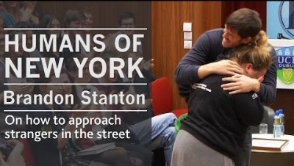
INTERVIEWING
Brandon Stanton

Slide 5
INTERVIEWING
Key things Brandon does to get a great interview.

Slide 6
INTERVIEWING
Level 1 Questions to get facts
Who What When Where
1
Level 2 Questions to get details
How many, what color, surroundings
2
Level 3 Questions to get opinions
Feel about, what made you…, what’s your opinion
3

Slide 7
Level 1 Questions
What did ____________
Did the ________
When were the ____________
Who was _____________
Answers result in FACTS that will not be used in quotes for the story
FACTS
Key Words To Use:
How, Who, What, When, List, Where, Tell, Define

Slide 8
Level 2 Questions
What happened when __________
How long did it take to ______________
Tell me what happened next when _________
DETAILS
Answers result in DETAILS that will be used for the lead or transistion
Key Words To Use:
Explain, Demonstrate, Relate, Show, Summarize

Slide 9
Level 3 Questions
How could you____________
Why do you think ______________
How did the ___________
What’s your opinion about ___________
OPINIONS
Answers result in OPINIONS and FEELINGS that will be used quotes
Key Words To Use:
how, what motive, explain, elaborate, formulate, estimate, interpret, what conclusions

Slide 10
GET SPECIFICS
Ask next level of question
Ask lots of whys and hows?
Look for touch, smell, see, hear
Show, don’t tell the reader

Slide 11
SHOW VS TELL
1
Maria’s friends gave her gifts for her birthday.
2
Maria unties the pooka dotted ribbon from the wrapped box. She looks around at her friends as her eyes begin to water. “You guys didn’t have to do this for me.”

Slide 12
NEW WAY
OLD STORY
What’s the story?
How can I tell the story of __ in a new way?
Where can I take my reader somewhere they’ve never been before?

Slide 13
LEAD
Inspired by his girlfriend, senior Kamryn Hannigan, senior Seth Miller ran for homecoming court to see what would happen. He won. So did she.

Slide 14
Homecoming King and senior Seth Miller is a squinter. He has never really liked bright lights, so at the first annual homecoming dance Oct. 19, the rave-type atmosphere of the dance floor filled with bright and colored lights wasn’t really Miller’s scene.
“Everywhere I went people would congratulate me for running in the first place and tell me they voted for me,” Miller said. “Which is super nice of them but it kind of got me freaked out because I was like shoot I might actually win this.”
When Student Council committed to organizing the homecoming dance, they planned to have a spotlight dance for the newly crowned king, queen and the rest of the court. At the dance, the D.J. didn’t want to take a break from the hype to slow things down for the dance.
The people who knew the couple the best were disappointed they didn’t get to dance, so senior Megan Novak suggested they do it with their flashlights in the parking lot instead.
“They were supposed to have the spotlight dance at the homecoming dance,” Novak said. “I thought [doing the dance anyway] would be fun. I just thought it would be something to remember.”
Miller and Hannigan agreed to dance, but Miller insisted they do it at the tennis court because, as a varsity tennis player, he was comfortable in the enclosed space. The couple and their friends walked to the courts after the dance to find the gate unlocked. Their friends turned on their flashlights and Miller started playing “Team” by Noah Cyrus & MAX. Their song.

Slide 15
“I am not much of a romantic person, but I knew Kamy wanted to do something like that,” Miller said. “I knew she had been kind of looking forward to a spotlight dance. I thought it was kind of sweet.”
The rave lights in the cafeteria might not have been Miller’s idea of a romantic spotlight dance, but the small lights from his nearby friends made for an even better one than the couple could have hoped for.
“It wasn’t as romantic as they portray a spotlight dance to be although it was probably better than doing it in front of the whole school,” Hannigan said. “It wasn’t as much a moment between Seth and I as a nice little group moment. It was really sweet our friends decided to take us out there and do that.”

Slide 16
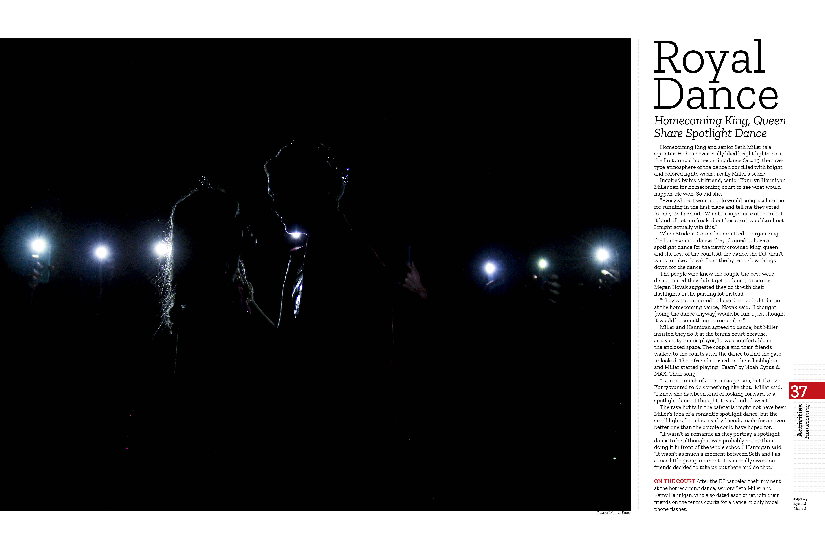

Slide 17
NEW WAY
OLD STORY
What’s the story?
How can I tell the story of __ in a new way?
Where can I take my reader somewhere they’ve never been before?

Slide 19
LEAD
Betty bought a bit of bitter butter, and Betty brought bounties of blinding talent. Betty might not be in improv, but they sure seem to talk about her a lot in vocal warm ups.

Slide 20
Sophomore Alyssa Briles warmed up before her audition for the improv troupe in August.
“Improv allows me to be myself on stage, and I get to make people laugh,” Briles said. “I love how anytime we have an improv show it’s always a night full of laughter.”
On Aug. 24, theater held open auditions for the improv troupe.
“It’s all made up on the spot. Before an audition, I try to stay as calm as possible because if I’m not I end up doing really bad at the audition. I like to prepare by thinking of possible solutions,” Briles said.
She walked on stage, in a shy voice se announced her name and got started. Walking like a monster, she was timid at first, but when she spotted the smiling faces of her friends she opened up.
“It felt like a familiar place. I could be myself,” she said.
She began to grin and completed the rest of her audition, she quickly transitioned from one concept to the next. Quickly, her time was up and she walks back off the stage.
“I felt ready for the audition, I felt more ready [than last year]. I got to have so much fun, I couldn’t stop
laughing,” Briles said.
Later, Briles received news: she made the team. “I hope that in the future the improv troupe becomes more known to people in the school and that more people want to join,” Briles said.

Slide 21
IN A FUN WAY
TELL STORIES
Find a theme
Find a universal
Creative writing

Slide 22
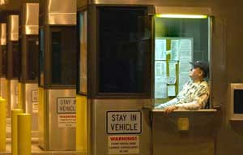
After the Sky Fell
Tampa Bay Times photo: Chris Zuppa
The loneliness of the overnight shift at a Suncoast Parkway toll booth: Lloyd Blair, 71, sits back and waits for the next driver to come by his station.

Slide 23
After the Sky Fell
The few drivers on this dark, lonely stretch of the Suncoast Parkway in Pasco County pull up to the toll booth, hand their dollars to Lloyd Blair and then speed away. None of them knows why the old man sits here, night after night, working the graveyard shift.
Well, here's why:
Because years ago, on a freezing winter night at a party in Queens, N.Y., he met a woman named Millie.
Because he fell in love with her brown hair and wide eyes and 100-watt smile.
Because they got married, moved to Staten Island, had a son and worked for decades in Manhattan; she as an accountant, he as a banker.
Because it had been their dream to retire to Florida, and so they saved all their lives to make it possible.
Because, just as they began to talk of leaving New York and heading south, she was diagnosed with breast cancer, and they spent their time and money traveling to New Jersey, San Diego and Mexico in search of a cure.

Slide 24
After the Sky Fell
Because, in the end, they came to Florida anyway.
Because they finally bought a house in Spring Hill, although she was too weak that day to get out of the car.
Because she died nine days later on Jan. 5, 2002, a day "the whole sky fell," he says.
Because, after she was gone, he found himself alone and $100,000 in debt.
And so he took a job collecting tolls. The drivers who pass by see a smiling 71-year-old man with blue eyes and a gray mustache who tells each of them, "Have a great night!"
They don't know the rest of Lloyd Blair's story, or that he keeps Millie's picture in his shirt pocket, just under his name tag, just over his heart.

Slide 25
TURN
YOUR
Pair up with someone you don’t know
Ask level 1, 2, 3 question
Write a lead to their story (you’ll introduce the person to the whole group)

Slide 26
TURN
YOUR
When Alex was born, he fit in the palm of his daddy’s hand.

Slide 27
TURN
YOUR
Chloe doesn’t remember the goose attack at age three, but the scar above her eye is a reminder and a great story for her to tell.

Slide 28
TURN
YOUR
Jackson should not be sitting here today. He should not be sitting anywhere. He should be buried next to his brother in Mississippi.

Slide 29
TURN
YOUR
What lead did you see a detail in your mind?
Whose story did you want to read more?
What story will you tell your mom about after this class?

Slide 30
Good Questions
Bad Questions
What
Why
How
If
Are
Have
Will
Do

Slide 31
WRITING
BETTER
INTERVIEWS
Leland Mallett
WALSWORTH YEARBOOKS
Leland.Mallett@Walsworth.com

